Slide 1
HTML (PART 2)
LIST & TABLES

Slide 2
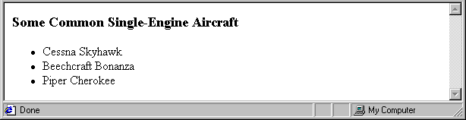
Lists
Unordered lists
The list is the content of the <ul> tag
List elements are the content of the <li> tag
<h3> Some Common Single-Engine Aircraft </h3>
<ul>
<li> Cessna Skyhawk </li>
<li> Beechcraft Bonanza </li>
<li> Piper Cherokee </li>
</ul>

Slide 3
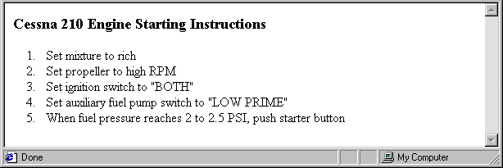
Lists (continued)
Ordered lists
The list is the content of the <ol> tag
Each item in the display is preceded by a sequence value
Nested lists
Any type list can be nested inside any type list
The nested list must be in a list item
<h3> Cessna 210 Engine Starting Instructions
</h3>
<ol>
<li> Set mixture to rich </li>
<li> Set propeller to high RPM </li>
<li> Set ignition switch to "BOTH" </li>
<li> Set auxiliary fuel pump switch to
"LOW PRIME" </li>
<li> When fuel pressure reaches 2 to 2.5
PSI, push starter button </li>
</ol>

Slide 4
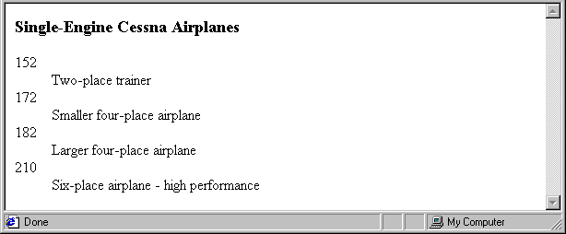
Lists (continued)
Definition lists (for glossaries, etc.)
List is the content of the <dl> tag
Terms being defined are the content of the <dt> tag
The definitions themselves are the content of the <dd> tag
<h3> Single-Engine Cessna Airplanes </h3>
<dl >
<dt> 152 </dt>
<dd> Two-place trainer </dd>
<dt> 172 </dt>
<dd> Smaller four-place airplane </dd>
<dt> 182 </dt>
<dd> Larger four-place airplane </dd>
<dt> 210 </dt>
<dd> Six-place airplane - high performance
</dd>
</dl>

Slide 5
Tables
A table is a matrix of cells, each possibly having content
The cells can include almost any element
Some cells have row or column labels and some have data
A table is specified as the content of a <table> tag
A border attribute in the <table> tag specifies a border between the cells
If border is set to "border", the browser’s default width border is used
The border attribute can be set to a number, which will be the border width
Without the border attribute, the table will have no lines!
Tables are given titles with the <caption> tag, which can immediately follow <table>

Slide 6
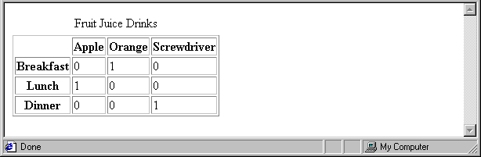
Tables (continued)
Each row of a table is specified as the content of a <tr> tag
The row headings are specified as the content of a <th> tag
The contents of a data cell is specified as the content of a <td> tag
<table border = "border">
<caption> Fruit Juice Drinks </caption>
<tr>
<th> </th>
<th> Apple </th>
<th> Orange </th>
<th> Screwdriver </th>
</tr>
<tr>
<th> Breakfast </th>
<td> 0 </td>
<td> 1 </td>
<td> 0 </td>
</tr>
<tr>
<th> Lunch </th>
<td> 1 </td>
<td> 0 </td>
<td> 0 </td>
</tr>
</table>

Slide 7
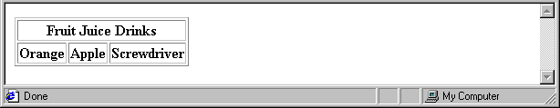
Tables (continued)
A table can have two levels of column labels
If so, the colspan attribute must be set in the <th> tag to specify that the label must span some number of columns
<tr>
<th colspan = "3"> Fruit Juice Drinks </th>
</tr>
<tr>
<th> Orange </th>
<th> Apple </th>
<th> Screwdriver </th>
</tr>

Slide 8
Tables (continued)
If the rows have labels and there is a spanning column label, the upper left corner must be made larger, using rowspan
<table border = "border">
<tr>
<td rowspan = "2"> </td>
<th colspan = "3"> Fruit Juice Drinks
</th>
</tr>
<tr>
<th> Apple </th>
<th> Orange </th>
<th> Screwdriver </th>
</tr>
…
</table>

Slide 9
Tables (continued)
The align attribute controls the horizontal placement of the contents in a table cell
Values are left, right, and center (default)
align is an attribute of <tr>, <th>, and <td> elements
The valign attribute controls the vertical placement of the contents of a table cell
Values are top, bottom, and center (default)
valign is an attribute of <th> and <td> elements
→ SHOW cell_align.html and display it
The cellspacing attribute of <table> is used to specify the distance between cells in a table
The cellpadding attribute of <table> is used to specify the spacing between the content of a cell and the inner walls of the cell

Slide 10
Tables (continued)
<table cellspacing = "50">
<tr>
<td> Colorado is a state of …
</td>
<td> South Dakota is somewhat…
</td>
</tr>
</table>
Table Sections
Header, body, and footer, which are the elements: thead, tbody, and tfoot
If a document has multiple tbody elements, they are separated by thicker horizontal lines

